Slide 1
SURVIVAL IN LONDON
MOHAMMAD MAAZ

Slide 2


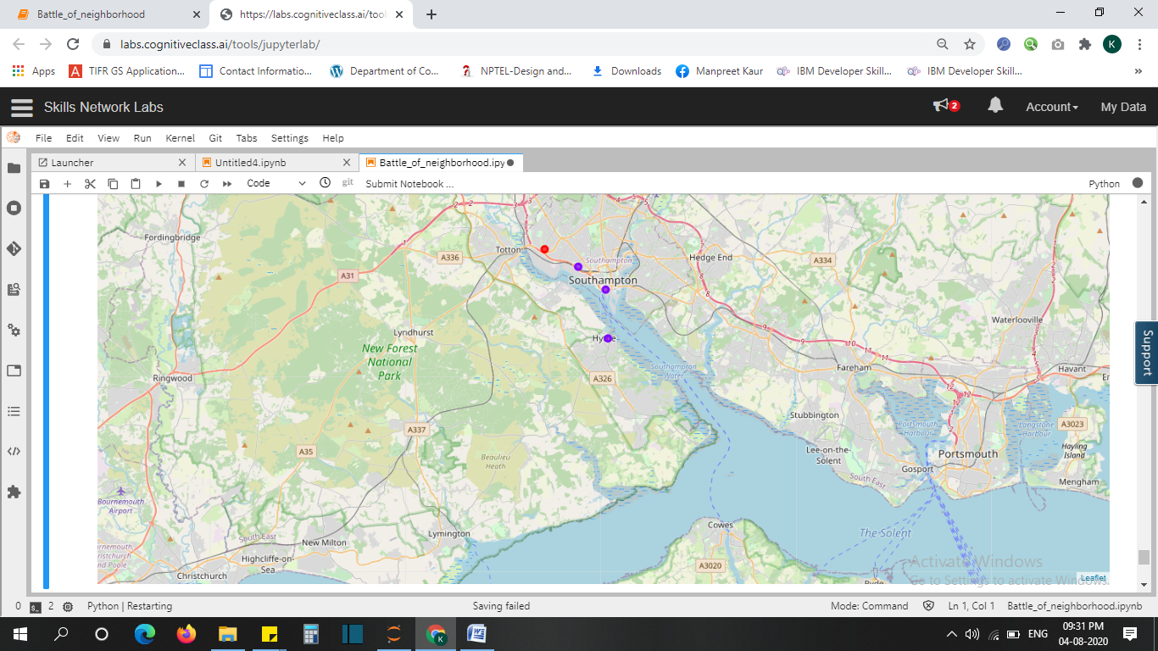
PROVIDING RECOMMENDATION USING DATA SCIENCE CAN BE HELPFUL
Exploring London and each of its streets for a cheap house
Using Foursquare API to explore other venues like food restaurants and pubs.
-Helping the customer by recommending a house within his/her budget with nearby facilities of food venues if he/she does not prefer cooking.
Great visualizations through graphs , charts and Southampton map

Slide 3



Data acquisition and cleaning
Used "HM Land Registry" dataset of UK for 2020 provided by UK govt at https://www.gov.uk/government/statistical-data-sets/price-paid-data-downlads
Used Foursquare API for latest updates and announcements regarding places of interest in Southampton

Slide 4
DATA ANALYSIS

Slide 5
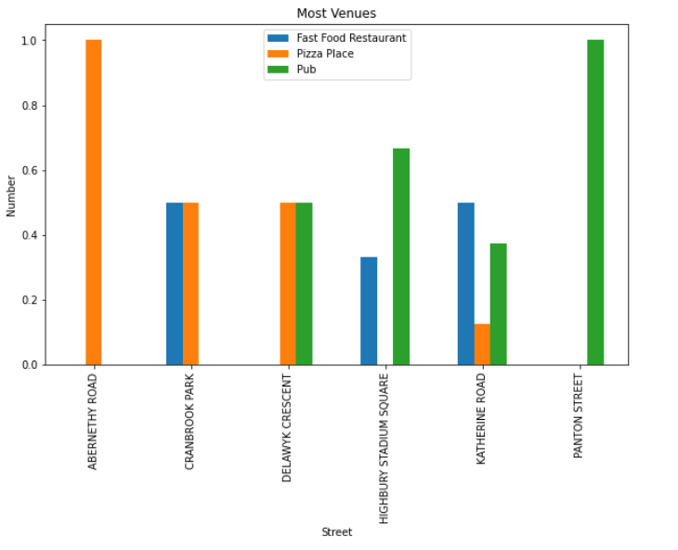
Visualizing top streets of London with cheapest average prices using a bar graph

Slide 6
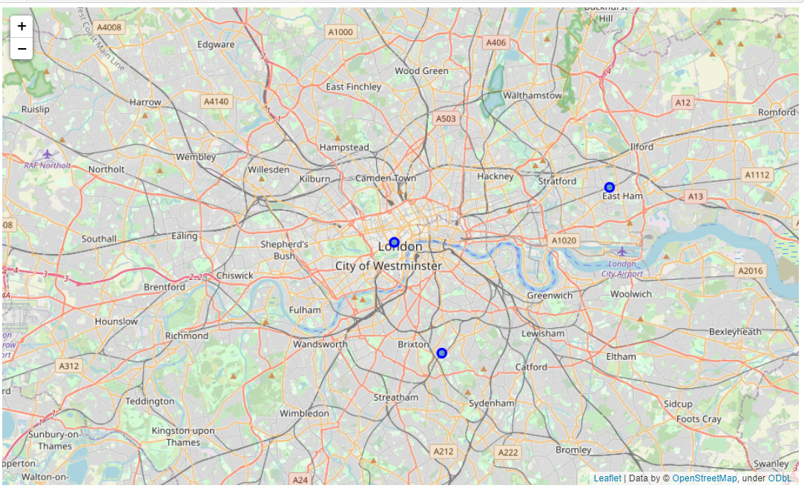
These streets we retrieved as the streets of interest along with their geo locations shown on the London map

Slide 7
CLUSTERING

Slide 8
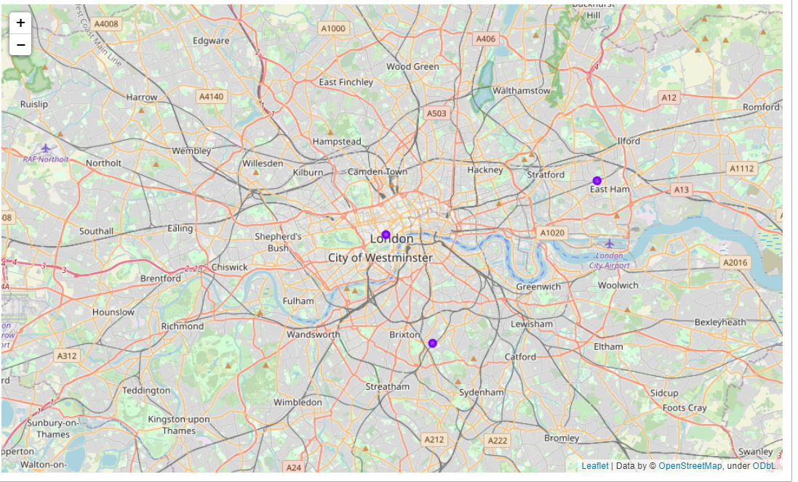
Using k-means clustering.

Slide 9
Conclusion
From data analysis it was concluded that the customer should buy a house in Abernethy Road at an average price of 5500.0 where he/she will get maximum benefits of Fast Food restaurants in comparison to any other neighboring streets.

